Slide 1
The PyData Ecosystem

Slide 2
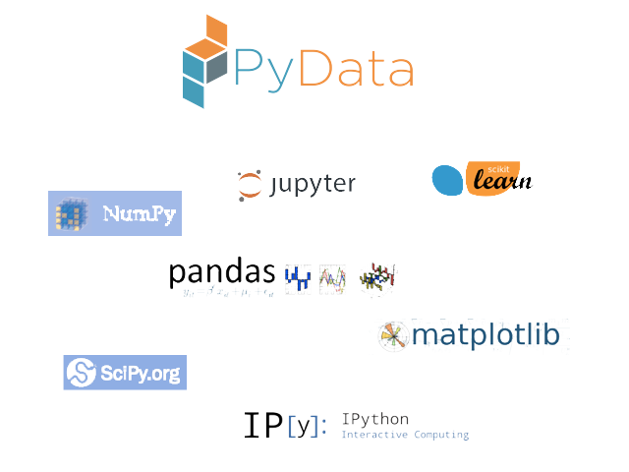


Slide 3
Covered in Class
IPython/Jupyter: simple, sharable notebooks
NumPy: efficient computations on matrices of numeric and Boolean data
Underlies most other data packages
Pandas: user-friendly manipulation of tabular data
MatPlotLib: data visualization
Good integration with Pandas
Notes:
Documentation for numpy: https://numpy.org/doc/

Slide 4
Not Covered in Class
SciPy: optimization, integration, clustering algorithms
Scikit-learn: machine learning algorithms
statsmodels: common models and tests from classical statistics

Slide 5
Summary
PyData is the most popular data analysis/numerical processing ecosystem in Python.
Used frequently over the coming months
Integral to data science using Python

Slide 6
The PyData Ecosystem

